Slide 1
CS 211 Final project
By Bradley Arline

Slide 2
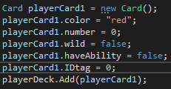
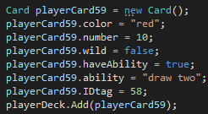
Overview of my uno project
What is a uno card?

Slide 3
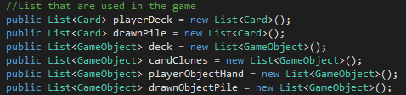
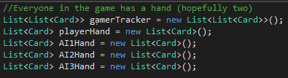
What data structures did I use

Slide 4
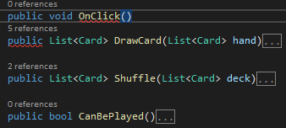
Functions used
Functions used

Slide 5
How does the game run?

Slide 6
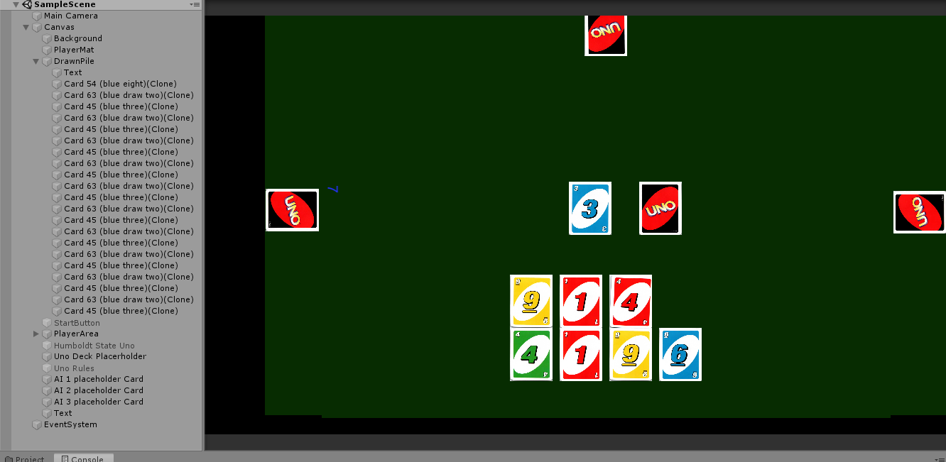

Problems...

Slide 7
What could I have done different

